Slide 1
Data Pipeline For Healthcare Companies
Group 2:
Avanti Dasre
Hetvi Patel
Shiva Ram Reddy
DATA 603
Professor Akshata Kishore Moharir
University of Maryland, Baltimore County

Slide 2
Problem Statement
Objective
Create a data pipeline geared towards healthcare insurance companies to help optimize their business strategies to increase revenue and improve member experience through data analysis and visualization.
WHAT: Our project is focused on creating a data pipeline for healthcare companies that receive large amounts of data on a daily basis. This data will need to be readily available for senior management to read and take action upon.
WHY: Due to the large amounts of data available to health insurance companies, they need to extract and transform data in order to make business decisions for their bottom line. Health insurance companies look at a myriad of factors such as a person’s age, smoking habits, alcohol intake, and overall general health before offering insurance to the applicant. By creating a data pipeline, company can easily analyze the data and decide whether to offer which groups of people insurance and at what premium. Other factors include reimbursement amount and inpatient deductible that increase the healthcare insurance company’s bottom line.
Why is a data pipeline needed?
Health care in U.S. is a contentious issue due to it’s high costs and accessibility to all.
Health insurance companies want to enhance their members’ experience through programs that would help their members get better benefits.
But, health insurance companies don’t have a direct line to data that has been centralized, verified for accuracy, and uniformed across all channels and sources.
Data pipelines are efficient and can be automated to reduce cost and labor.

Slide 3
Solution
HOW: There are multiple ways data is generated in a health care system. Understanding how data is moved in the healthcare system and create a robust system for data and information flow is important. As healthcare data comes in huge volumes, data does not always make sense when it is unaggregated and not processed. Instead, the value of the data is produced when one is able to efficiently translate data into actionable steps and digestible information by folks without technical background.
We propose a solution where end to end data flow architecture is designed for efficient flow of data between different stakeholders.
First, we will source data obtained from the insurance company itself, extract the data, perform data cleanup, and loaded into a database. From there, we will create buckets of categories such as member age, gender, and sample of diseases. This will help us quantify categorical variables.
Lastly, we will create visualizations per business requirements that will help translate large swaths of data into informative graphs that senior management can utilize to make actionable recommendations.

Slide 4
Dataset
Using 3 datasets: ‘train_beneficiary’, ‘train_inpatient’, and ‘train_outpatient’
Joined 3 datasets using ‘BeneID’ column as the primary key
It contains and represents unique identification characters for beneficiaries who are members of this healthcare insurance company.
173,582 rows and 26 columns as parameters
A few of them: BeneID, DOB, DOD, Gender, Race, State, Renal Disease Indicator, 11 diseases, inpatient and outpatient annual reimbursement amounts, inpatient and outpatient deductible amounts, and inpatient and outpatient insurance claim amount reimbursed.
Rows represent each time a member made a claim and is linked to the member’s ‘BeneID’
Created ‘Member Age’ column using DOB and DOD columns
This dataset shows how many times a member started a claim under which disease.
Demographic data such as age and gender is helpful to group members into certain categories such as high risk based on disease codes claim(s) were filed under.

Slide 5
Framework & Technology Stack for Data Pipeline
Data Source
Collection
Processing
Storage
Consumption
Kaggle
Databricks
Apache Spark
Numpy, Pandas, Matplotlib, and Seaborn libraries
Push data frames to Hive
Apache Spark
Joining dataframes using primary key
Exploratory Data Analysis
Importing Libraries
Ingesting 3 datasets into data frames
Dropping columns
Advanced analytics using parameters and categorical variables
Removing nulls
Caching data frames
Statistical analysis

Slide 6
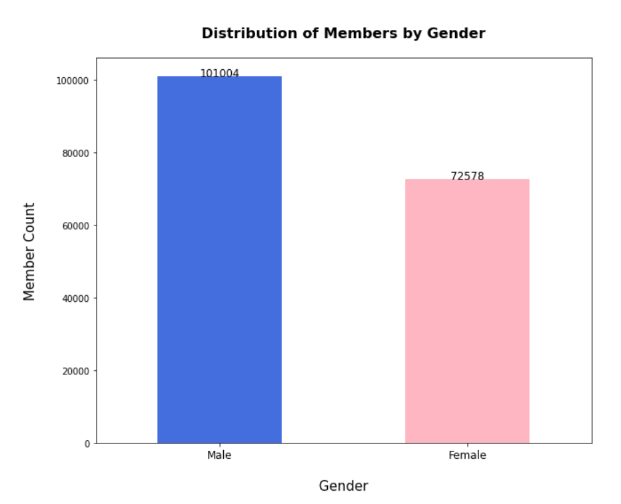
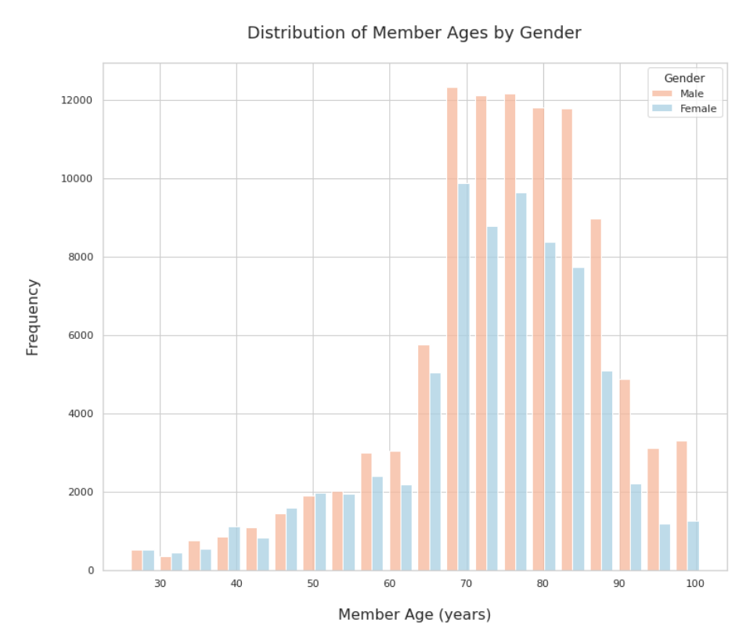
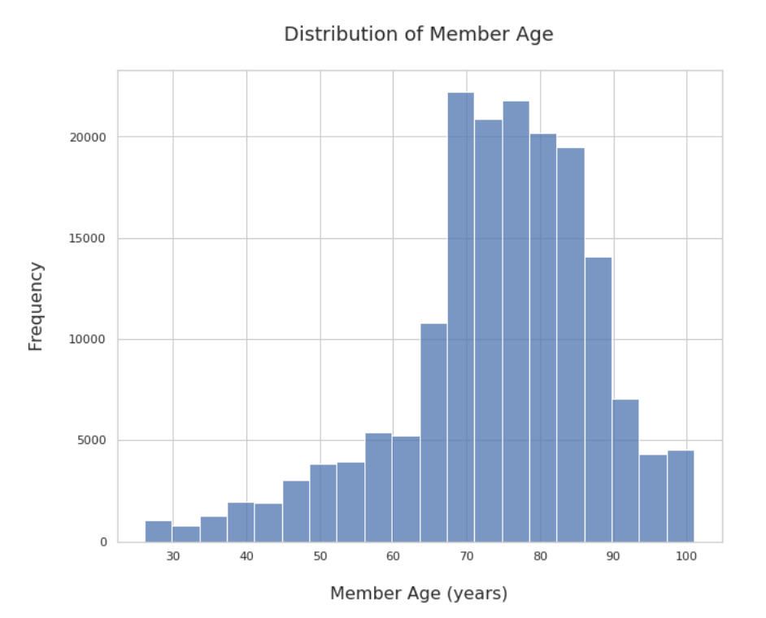
Results: Top Features & EDA

Slide 7
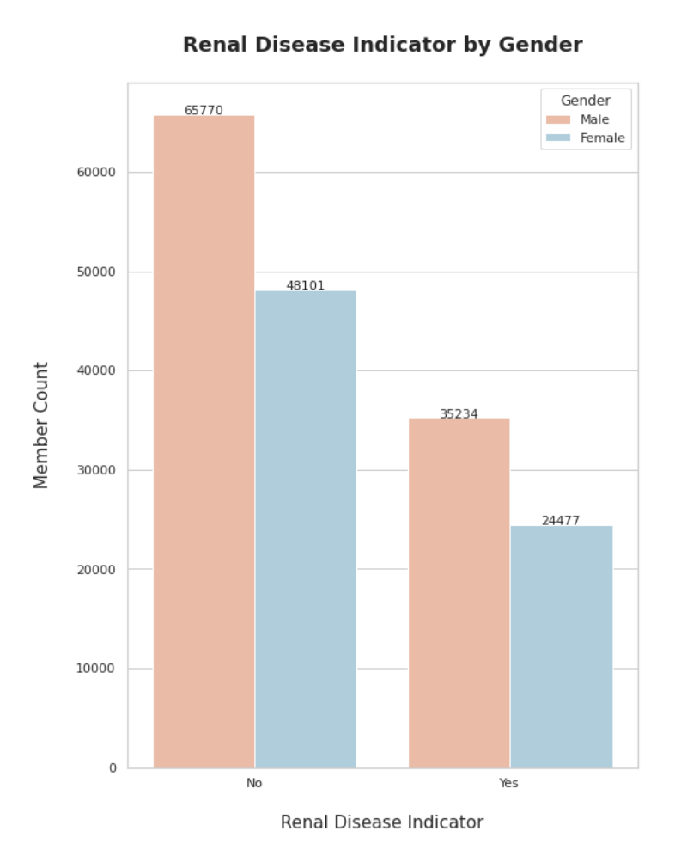
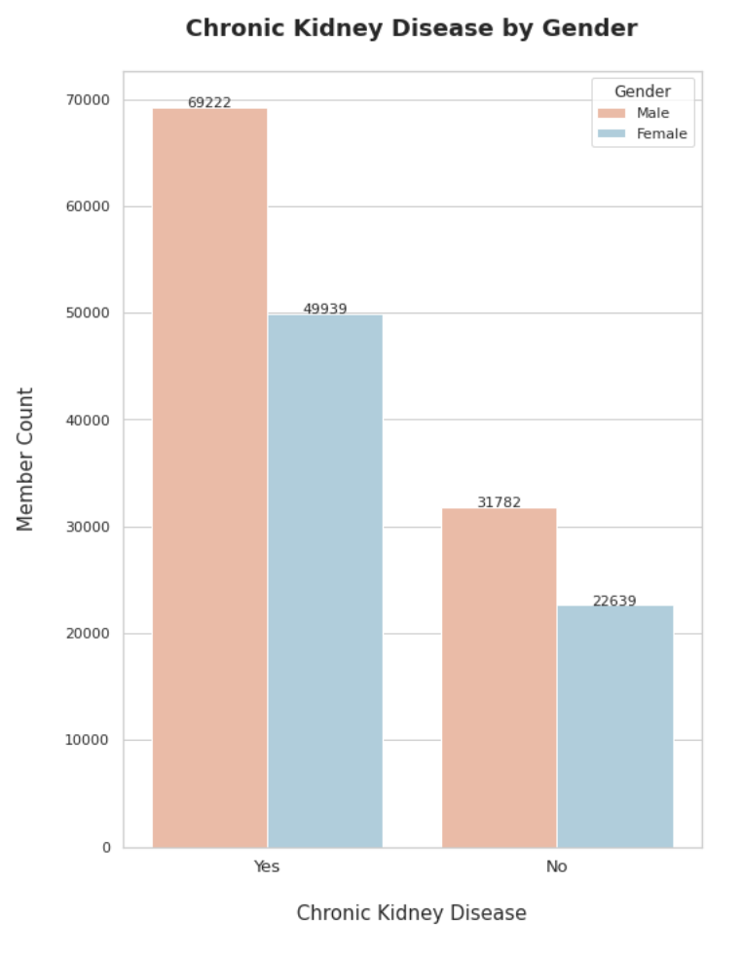
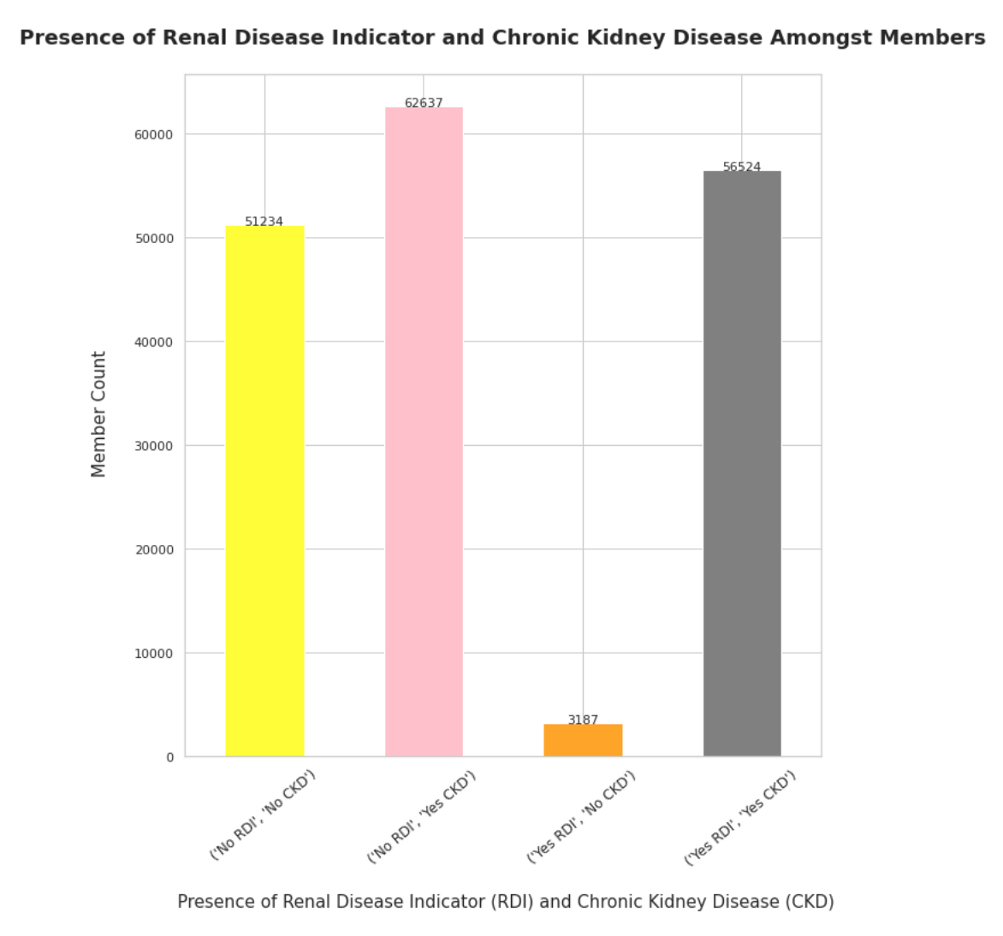
Results: Renal Disease Indicator and Chronic Kidney Disease (CKD)
Notes:
Hetvi

Slide 8
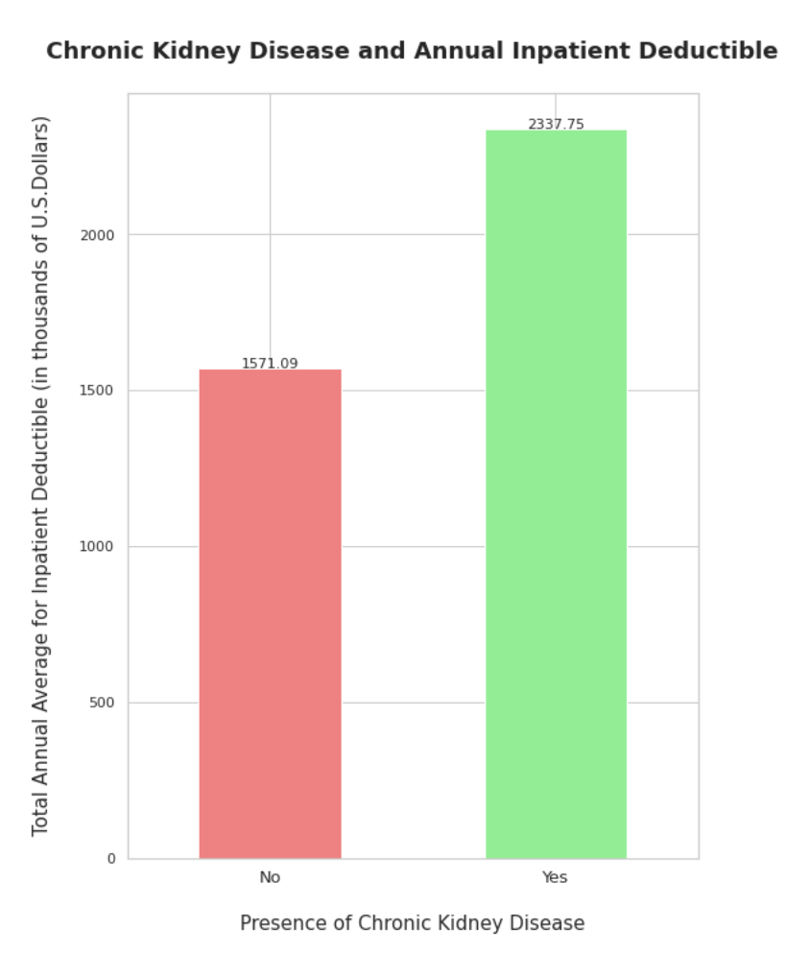
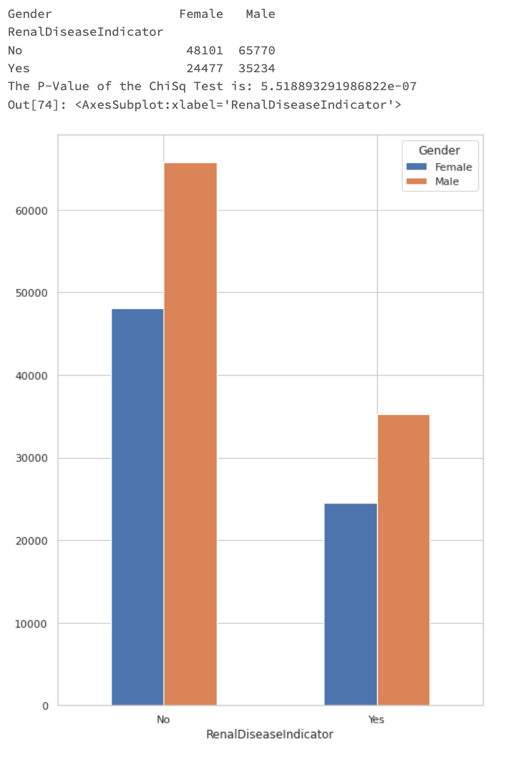
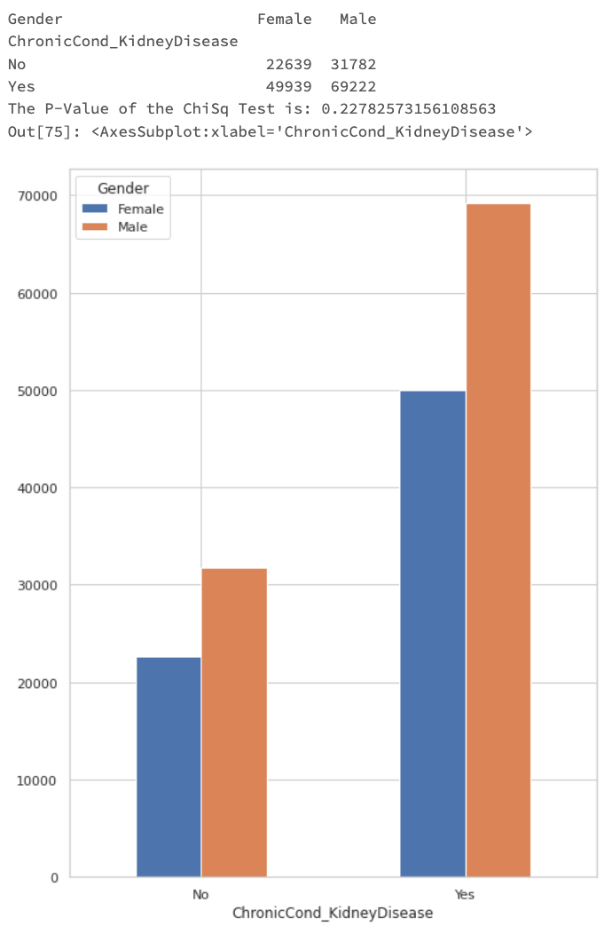
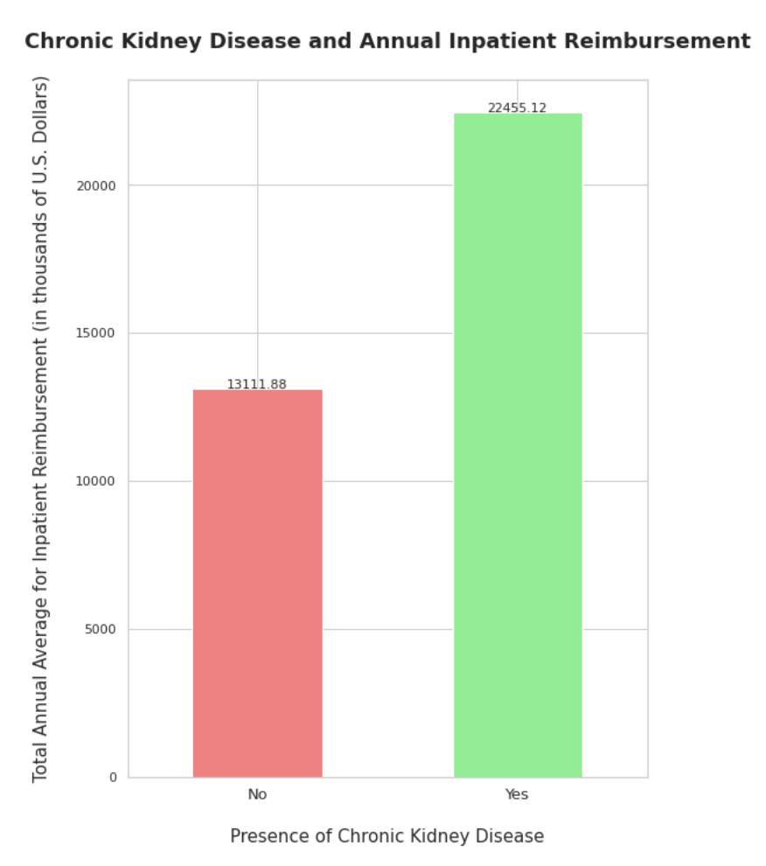
Results: Renal Disease Indicator and Chronic Kidney Disease (CKD)
Notes:
Hetvi

Slide 9
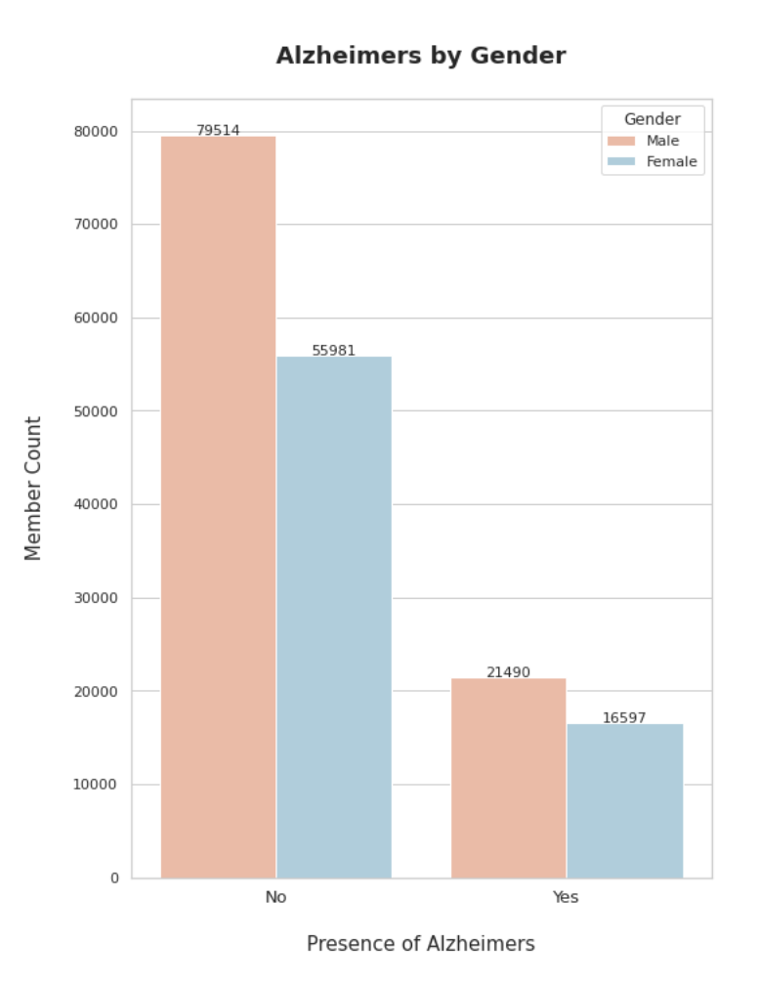
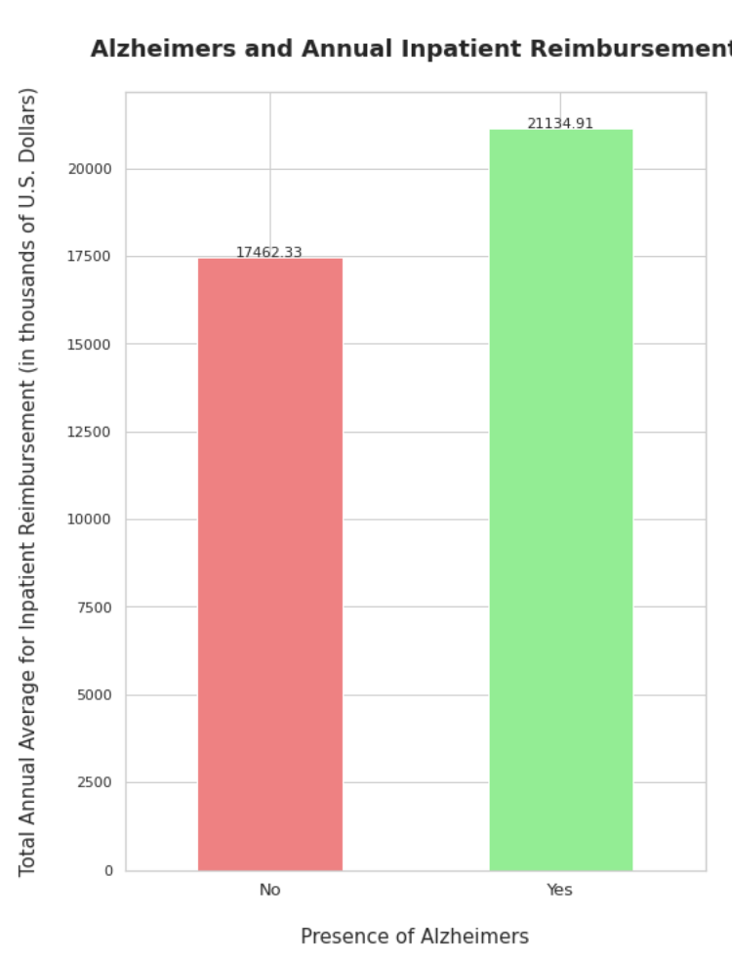
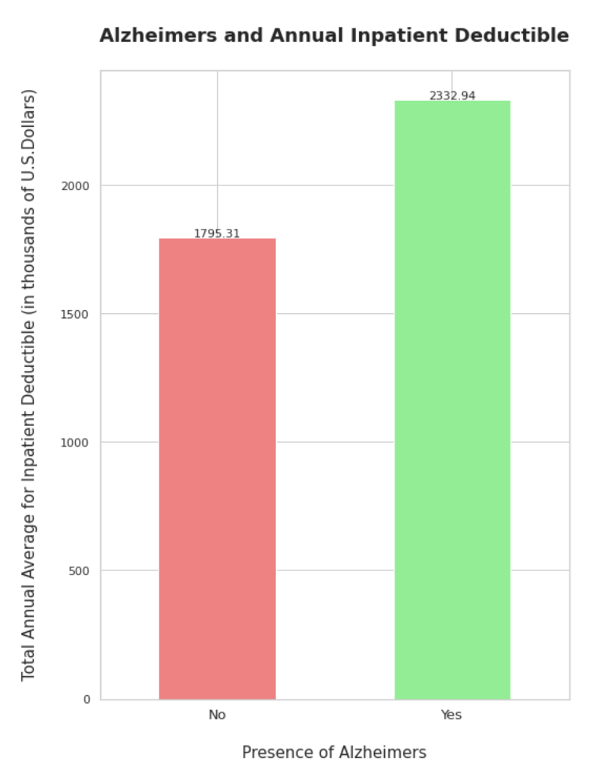
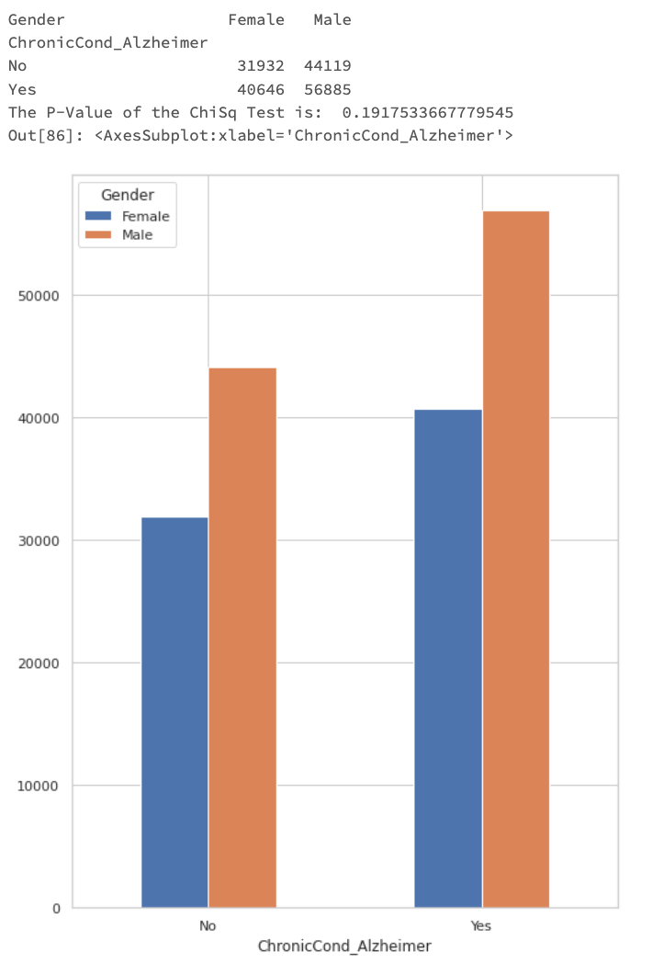
Results:Alzheimer’s
Notes:
Hetvi

Slide 10
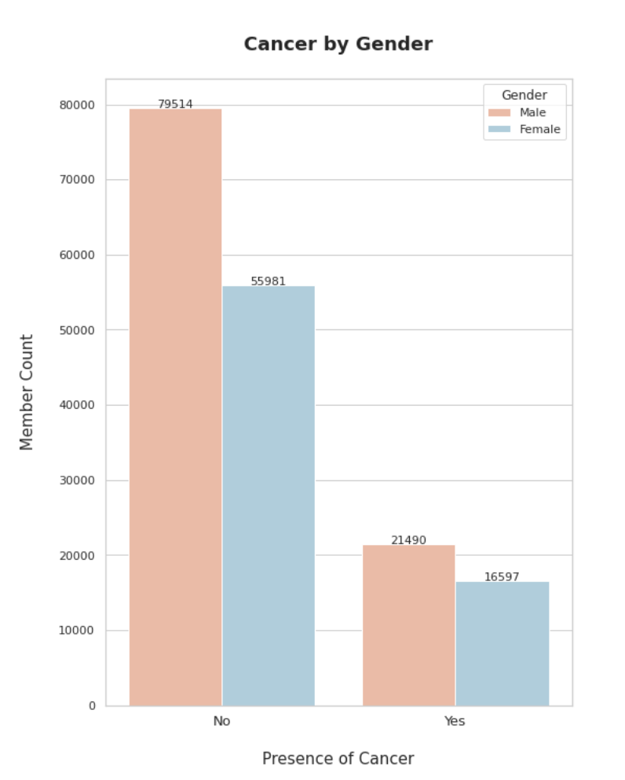
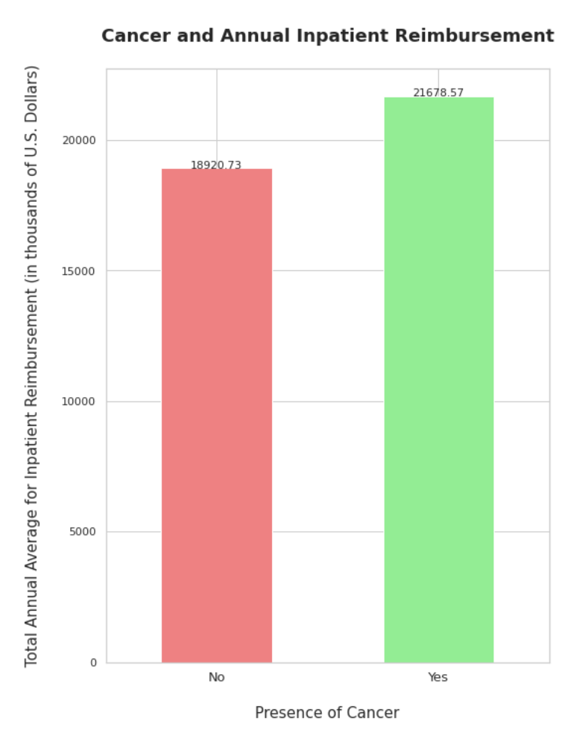
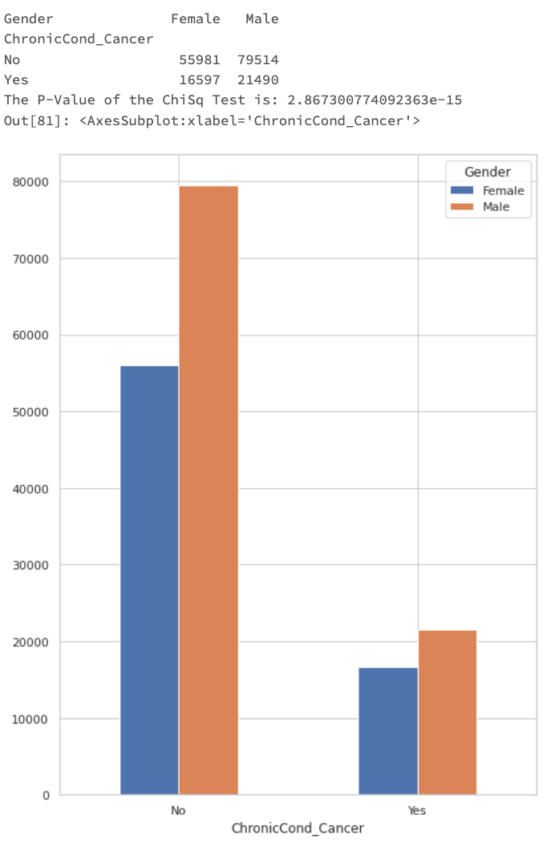
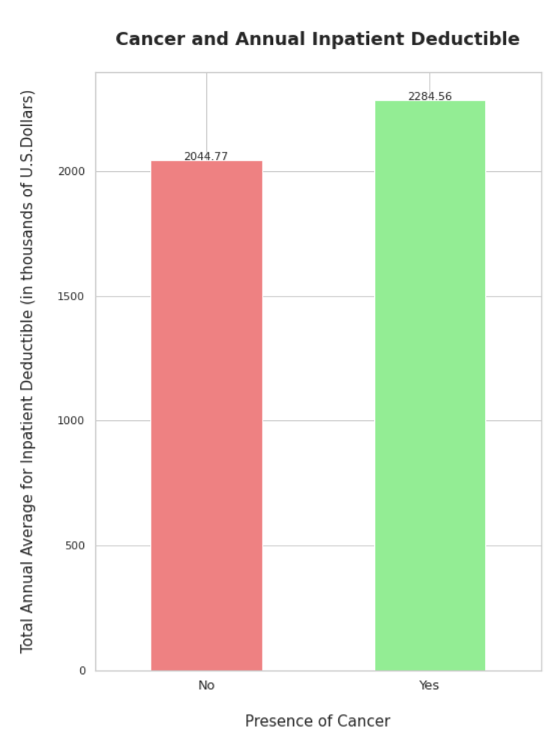
Results:Cancer
Notes:
Hetvi

Slide 11
Impact to health care insurance company
Impact to the members
Company can make appropriate business strategies to enhance their revenue by identifying which members are at high risk for chronic diseases.
For members with chronic diseases: Increase member inpatient deductible or copayment amount by a factor as they would pose a higher risk to the company
Example: CKD and presence of renal disease indicator
Doing so lowers the company’s reimbursement amount
If members with no disease presence are paying higher deductible, lower amount
Elder members: mobile clinics and online pharmacies for a small fee
Rideshare services to take members to clinical appointments and treatments
Expand operational services and offices in states with a higher population of members
Members with CKD: partner clinic to offer dialysis treatments or a subscription to a diabetes monitoring device for a fee
Members with Cancer: Partner with Make-A-Wish Foundation and therapists for members to attend sessions
Members with Alzheimer’s: adult day care, senior living centers, or stay-at-home senior care

Slide 12
References and GitHub Link
Gupta, R. A. (2019, May 9). Healthcare Provider Fraud Detection Analysis. Kaggle. Retrieved October 15, 2022, from https://www.kaggle.com/datasets/rohitrox/healthcare-provider-fraud-detection-analysis
Mayo Foundation for Medical Education and Research. (2021, September 3). Chronic kidney disease. Mayo Clinic. Retrieved November 14, 2022, from https://www.mayoclinic.org/diseases-conditions/chronic-kidney-disease/symptoms-causes/syc-20354521#:~:text=Diabetes%20is%20the%20most%20common,to%20long%2Dterm%20functional%20decline.
Chou, V. (2019, February 27). How science and genetics are reshaping the race debate of the 21st Century. Science in the News. Retrieved November 14, 2022, from https://sitn.hms.harvard.edu/flash/2017/science-genetics-reshaping-race-debate-21st-century/#:~:text=(A)%20The%20old%20concept%20of,a%20relatively%20uniform%20genetic%20identity.
List of states in the United States. Drupal.org. (2016, December 9). Retrieved November 14, 2022, from https://www.drupal.org/node/332575
Leena, P. (2022, October 4). Inpatient vs. outpatient: What employers need to know. Mednefits. Retrieved November 24, 2022, from https://www.mednefits.com/blog/inpatient-vs-outpatient-what-employers-need-to-know/
Centers for Disease Control and Prevention. (2022, September 6). FASTSTATS - leading causes of death. Centers for Disease Control and Prevention. Retrieved November 24, 2022, from https://www.cdc.gov/nchs/fastats/leading-causes-of-death.htm
What is cancer?: Cancer basics. American Cancer Society. (n.d.). Retrieved November 24, 2022, from https://www.cancer.org/treatment/understanding-your-diagnosis.html.
What is Alzheimer's Disease? Alzheimer's Disease and Dementia. (n.d.). Retrieved November 24, 2022, from https://www.alz.org/alzheimers-dementia/what-is-alzheimers

